Slide 1
An Explainable Machine Learning-Based Fraud Detection System

Slide 2

Problem Statement
In recent years, there has been a significant increase in the volume of financial transactions due to the expansion of financial institutions and the popularity of web-based e-commerce (Enaifoghe, 2026).
Fraudulent transactions have become a growing
problem in online banking, and fraud detection has always
been challenging (Nanduri et al., 2020).
Along with credit card development, the pattern of credit
card fraud has always been updated. Fraudsters do their
best to make it look legitimate, and credit card fraud has
always been updated.
They try to learn how fraud detection systems
work and continue to test these systems, making fraud
detection more complicated.
Therefore, we are trying to find new ways to improve the performance of the existing methods.

Slide 3
Data Understanding
The PaySim dataset is a synthetic financial log generated via Multi-Agent Based Simulation to model mobile money transactions while overcoming the privacy restrictions associated with real-world financial data. Scaled from a month of transactional logs from an African mobile money provider, the dataset consists of over 6.36 million records spanning 30 days (744 temporal steps, where each step represents 1 hour).

Slide 4
Exploratory Data Analysis

Slide 5
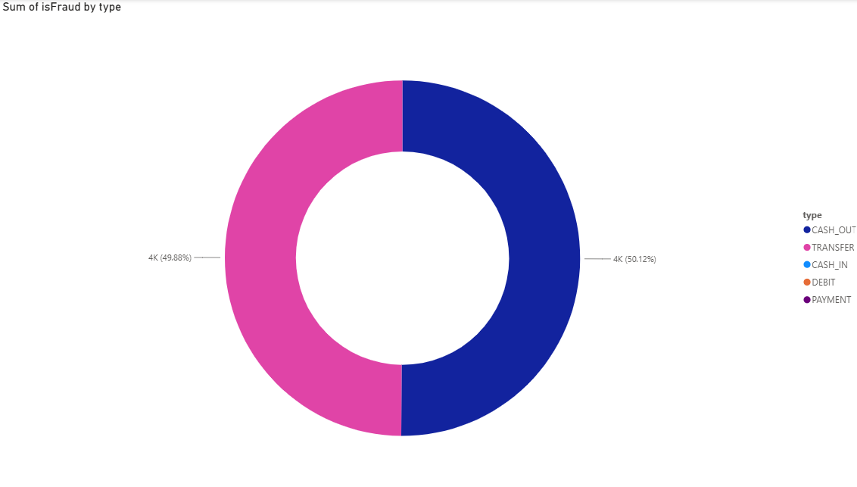
Fraud Distribution Between Transfer and Cash Out
Fraud is almost evenly split between TRANSFER and CASH_OUT transactions. Each type accounts for roughly half of all fraud cases. This means both transaction types are equally risky and need close monitoring.

Slide 6
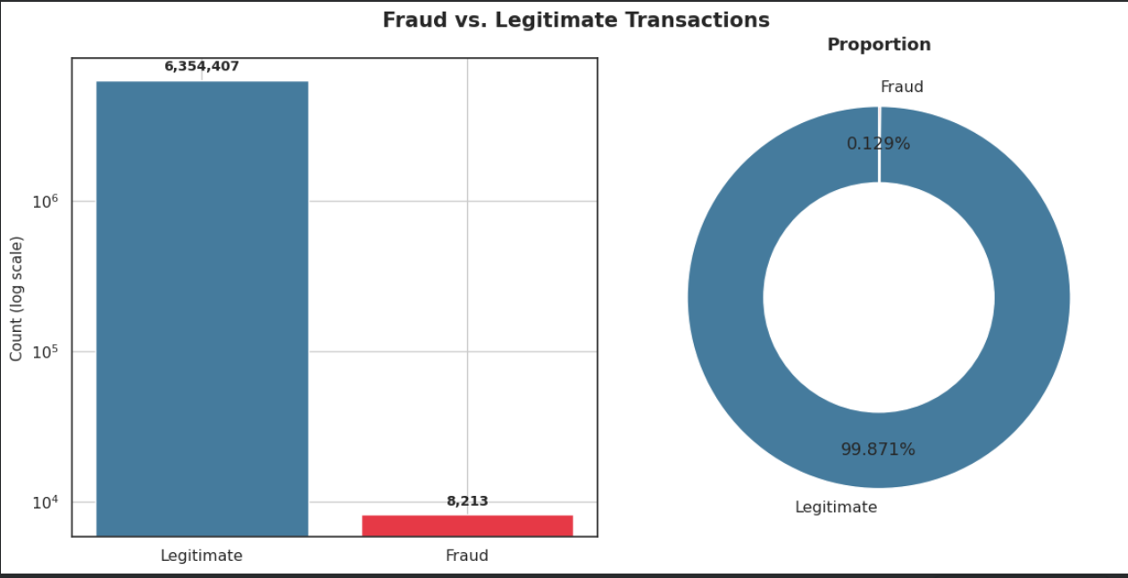
Out of 6,362,620 total transactions, only 8,213 are fraudulent — that's 0.129%, or roughly 1 in every 775 transactions.
The bar chart uses a log scale because on a normal scale, fraud would be invisible next to legitimate volume.
The donut chart shows the same story as a proportion: 99.87% legitimate vs. 0.13% fraud.
Why it matters:
A model could hit 99.8%+ accuracy just by labeling everything "not fraud" — so accuracy alone is a useless metric here.
This is the core justification for balancing the dataset (under sampling) before training any model.

Slide 7
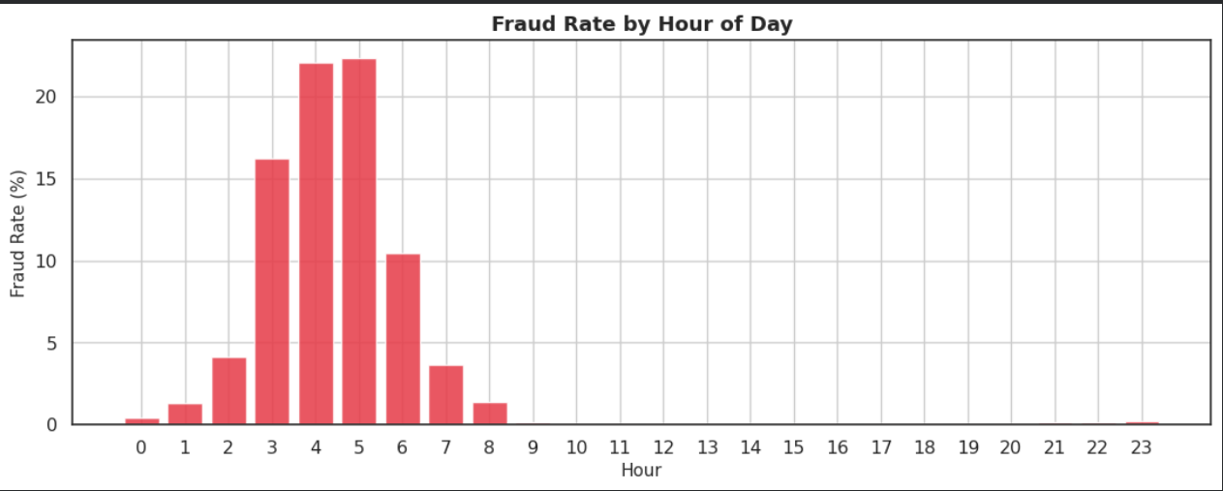
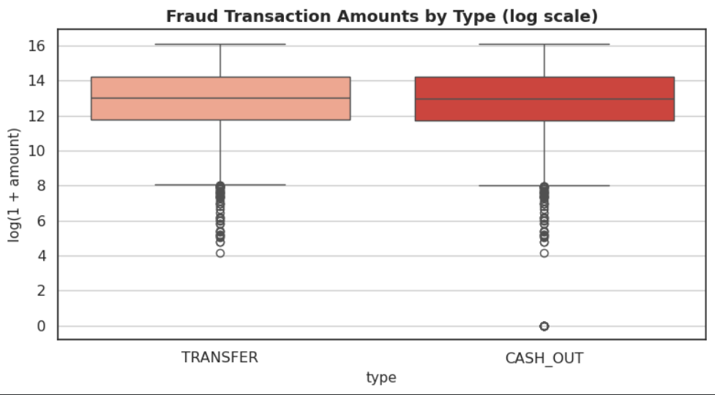

Slide 8
Data Preprocessing
Check for missing values
Features Scaling
Encode Categorial Variables
Check Duplicate Rows
Feature Engineering
Feature Importance

Slide 9
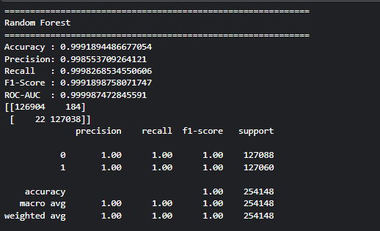
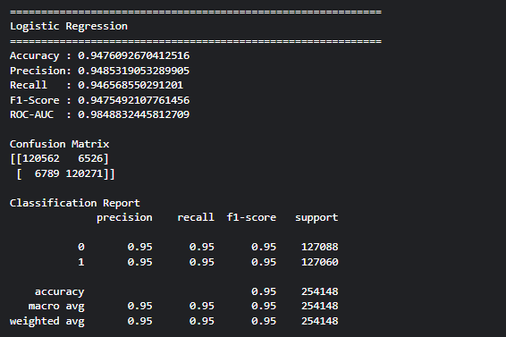
Model Development and Selection
Random Forest
Logistic Regression

Slide 10
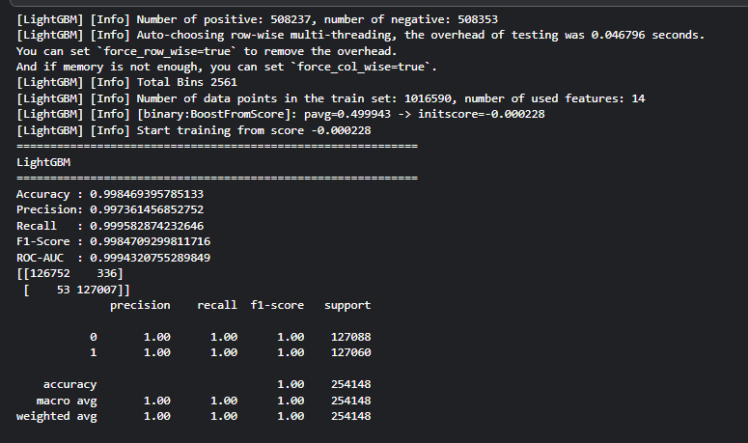
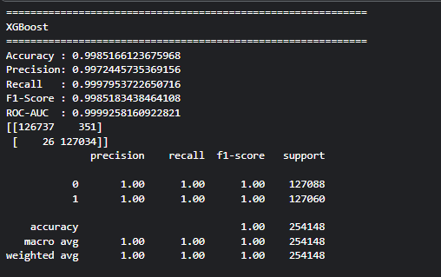
Model Development and Selection
eXtreme Gradient Boosting (XGBoost)
Light GBM

Slide 11
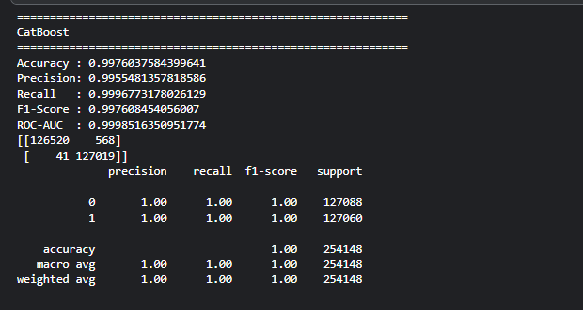
Model Development and Selection
CatBoost

Slide 12
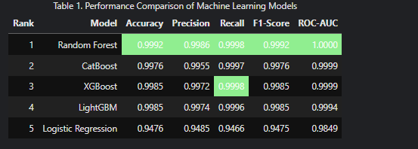
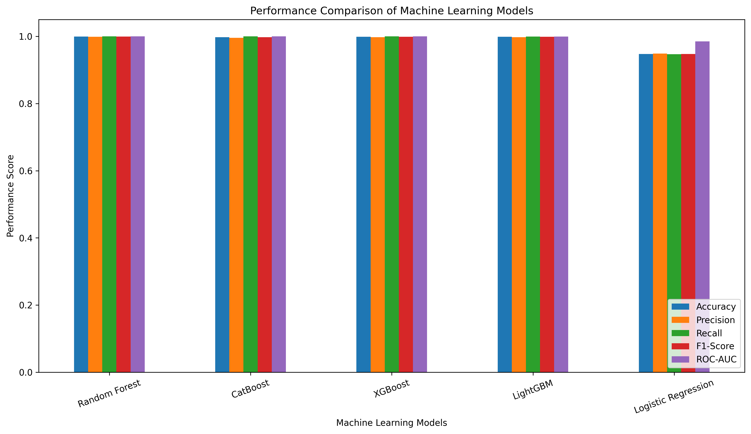
Model Performance

Slide 13
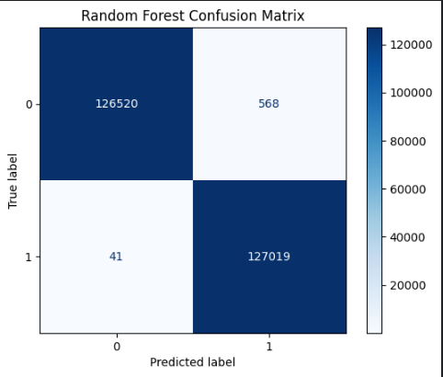
Model Performance

Slide 14
EXPLAINABLE ARTIFICIAL INTELLIGENCE

Slide 15
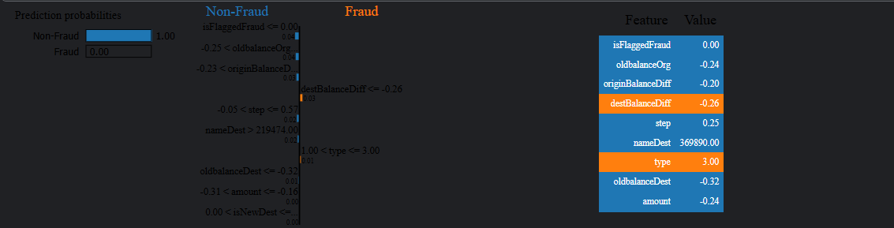
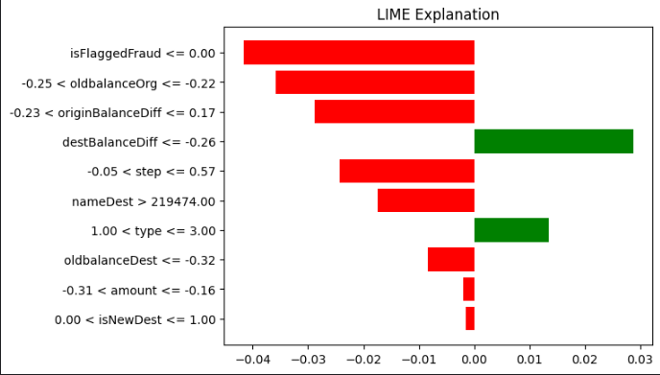
LIME

Slide 16

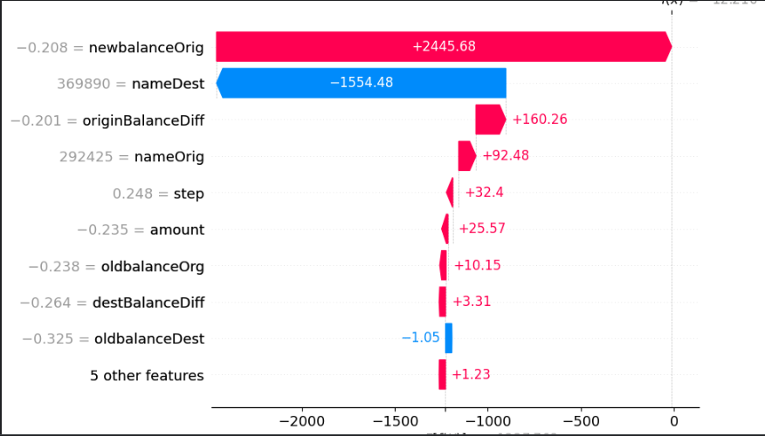
SHAP

Slide 17
Proposed Solution - Extra Security Layer
Problem: Most fraud happens in TRANSFER and CASH_OUT
Solution: Add face recognition for BOTH sender and receiver before the transaction completes
How it works:
1. You verify with Face ID to send money
2. Receiver verifies with face ID to receive money
Result: Blocks account takeover + fake accounts + stolen card fraud
Business Value: Extra layer that stops 90% of common fraud without slowing legit customers

Slide 18
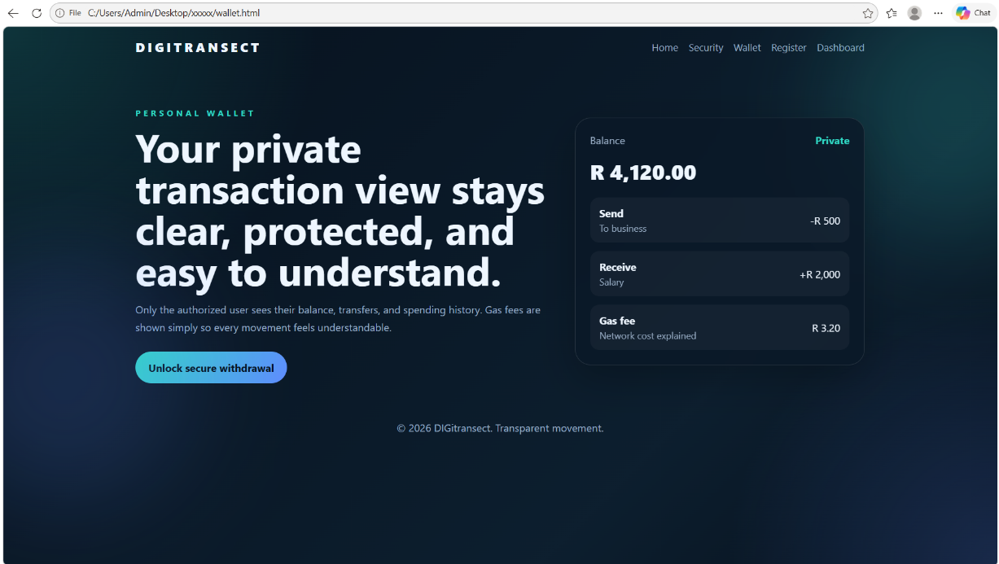
Proposed Solution - Extra Security Layer

Slide 19
Conclusion
The project successfully processed more than 6.3 million mobile money transactions from the PaySim dataset, with no missing, duplicate, or corrupted records, confirming the dataset's quality and suitability for machine learning. Exploratory data analysis provided valuable insights into transaction types, transaction amounts, and transaction patterns over the 30-day simulation period. A major finding was the severe class imbalance between legitimate and fraudulent transactions, which presents a challenge for accurately detecting fraud. The next phase will focus on applying data balancing techniques and training advanced machine learning models, which will be evaluated using metrics such as Precision, Recall, F1-score, ROC-AUC, and Precision-Recall AUC to develop an effective fraud detection system.

Slide 20
Thank You!

Slide 21
Reference List
Enaifoghe, A. (2026). The Rapid Growth of Digital Banking Services on Customer Behaviour and Satisfaction in South Africa. Intechopen.com. [online] doi:10.5772/intechopen.1012046.
J. Nanduri, Y.-W. Liu, K. Yang, and Y. Jia, ‘‘Ecommerce fraud detection through fraud islands and multi-layer machine learning model,’’ in Proc. Future Inf. Commun. Conf., in Advances in Information and Communication. San Francisco, CA, USA: Springer, 2020, pp. 556–570.

